Slide 1
Husky ADAPT VIP
Weekly AOI: Week 9
Transfer Team
Hyeongju Choi, Ritika Gupta, Jasmine Hawkins,
Sharon Heung, YoonBo Shim

Slide 2
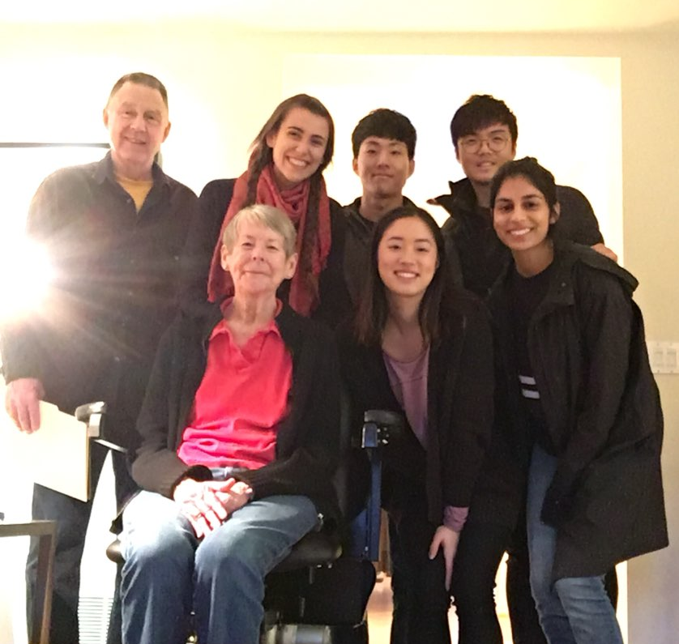
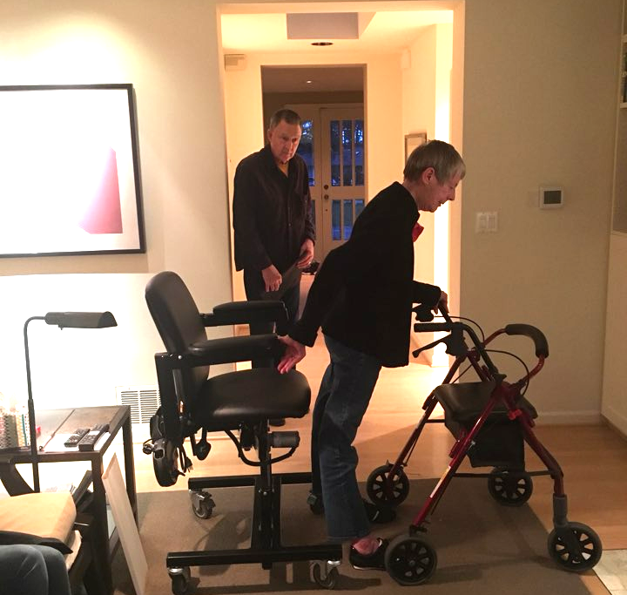
Accomplishments
Met with Carolee and Tom
  Took videos and photos of Carolee transferring
  Ranked design specs - top four were safety, ease of use, independence, and comfort
  Discussed and ranked each design idea
    Carolee and Tom were most excited about the gas spring + harness mechanism, and the resistance band

Slide 3
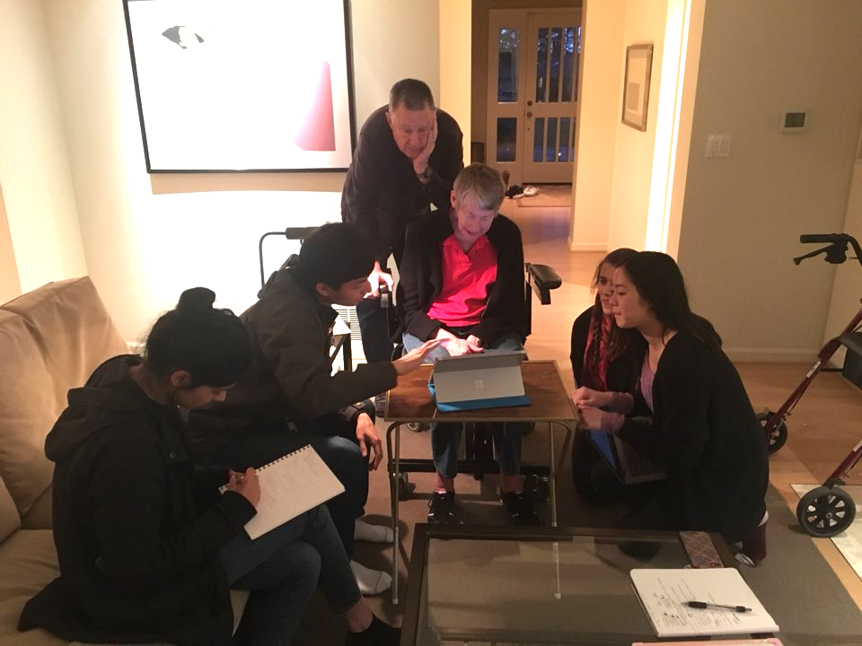
Objectives
Create our poster for the Fall Design Review
Look further into the mechanism of the harness and gas spring
Explore the resistance band, if time permits

Slide 4
Issues
No issues!

